Slide 1


The Controlled Delivery of Hydrogen Sulfide for the Preservation of Heart Tissue
Team Organ Storage and Hibernation
Elizabeth Chen, Charles Chiang, Steven Geng, Elyse Geibel,
Stevephen Hung, Kathleen Jee, Angela Lee, Christine Lim,
Sara Moghaddam-Taaheri, Adam Pampori,
Kathy Tang, Jessie Tsai, Diana Zhong
Mentor: Dr. John P. Fisher
Notes:
JAZZ – color ? Logos (gemstone, HHMI, dr. fisher)

Slide 2
Overview
Introduction
  Organ Shortage
  Current Methods of Preservation
Background
  Ischemia Reperfusion Injury
  Hydrogen sulfide attenuates injury
Research Question
Methodology
Results
Conclusions

Slide 3
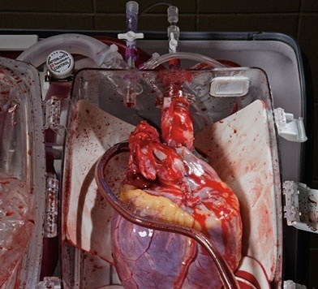
Organ Shortage
100,000 patients on organ transplant waiting list
Only 77 patients receive transplants daily
Heart preservation limited to 4-6 hours
http://singularityhub.com/2009/06/17/a-look-at-heart-transplants/
Notes:
Organ Shortage
Over 100,000 people on organ transplant waiting list
Only 77 of these patients receive transplants daily
Hearts limited to 4-6 hours in storage
Preservation-related injury
3

Slide 4
Our Goal
Develop a strategy for increasing the viability of stored organs and thus improving patient outcomes

Slide 5
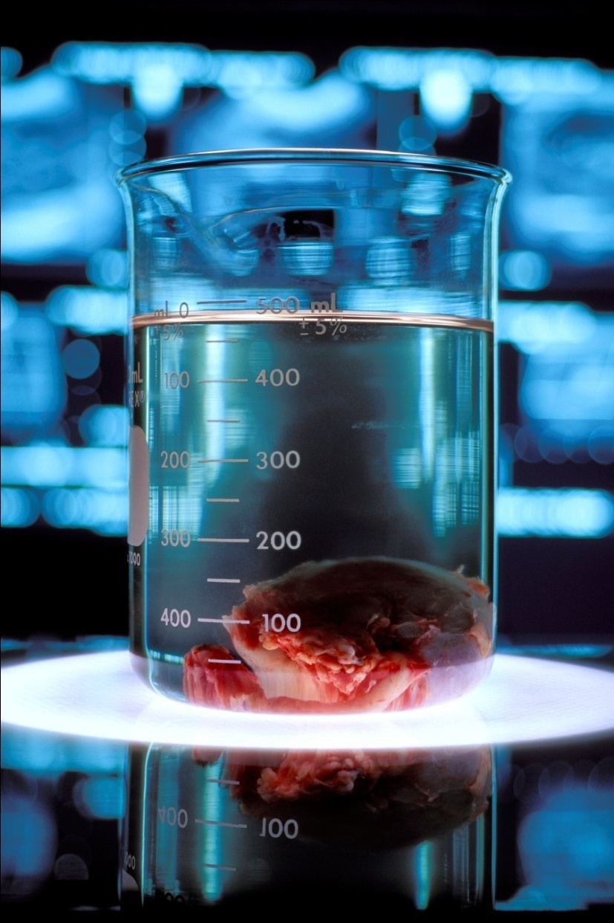
Current Organ Storage Methods
Continuous perfusion
  Organ Care System
  Effective but expensive
Static cold storage
  University of Wisconsin solution
Lack of blood flow leads to I/R injury
http://www.news.wisc.edu/newsphotos/uwsolution.html
Notes:
Static cold storage
University of Wisconsin solution
No significant improvements in last two decades
Continuous perfusion
Organ Care System
Effective but expensive
5

Slide 6
Cold Ischemia Leads to I/R Injury
Cardiomyocyte
Continued metabolism
ATP depletion
Accumulation of metabolic waste products
Acidosis
Na⁺
Continued cell processes
Na pump
Ionic balance disruption
Less active ionic pumps
Na⁺ and Ca²⁺ accumulate
Cell swelling
ATP
Lactate, hypoxanthine
ROS
O₂
Mitochondria
Calcium pump
ROS production
Inefficiencies in electron transport chain lead to ROS
Ca²⁺
Adapted from: Di Lisa et. al 2007, Jamieson et. al 2008
Notes:
6
[add citations]
This is appropriate where it is but it must be explained as a reason for WHY we even used microspheres in the first place. Say “we used microspheres because this is a problem that exists”
ALL SLIDES NEED VERBAL TRANSITIONS
This scheme needs to be highly simplified so that it only states the first step and maybe one intermediate step that leads to the end (i.e. ROS are created) this should not take a lot of time to explain.
6

Slide 7
Reperfusion Exacerbates Injury
Cardiomyocyte
ROS Burst
Waste products fuel ROS generation
O₂
ROS
Release of cyto c
ATP
Mitochondria
protons
Mitochondrial Permeability Transition Pore Opens
Protons leak out, no ATP generation
Adapted from: Di Lisa et. al 2007, Jamieson et. al 2008
Notes:
7
[add citations]
7

Slide 8
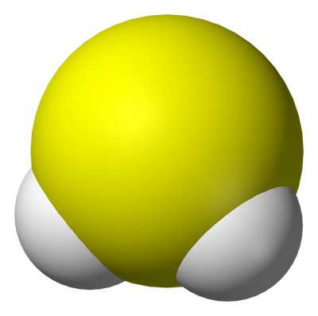
Our Solution: Hydrogen Sulfide (H₂S)
H₂S
  Colorless, poisonous gas
  Endogenously produced by cells
  Plays critical role in vasoregulation
  NaHS is a precursor of H₂S
Recent studies
  Induced suspended animation in mice¹
  Improved left ventricular developed pressure (LVDP)²
  Preserved ATP levels, reduced infarct size³
Molecular structure of H₂S
1. Blackstone et al. 2005
2. Li et al. 2007
3. Sivarajah et al. 2006
Notes:
H2S is a chemical compound that is a colorless, very poisonous, flammable gas with the characteristic foul odor of rotten eggs
Improved left ventricular developed pressure (LVDP) after reperfusion¹
Preserved ATP levels and reduced infarct size significantly better than conventional preservation methods
Endogenously produced from the breakdown of cysteine
Mice survived hypoxic conditions for 24h
Endogenously produced by cells
Also produced by intestinal flora
"our goal is to..."
8

Slide 9
H₂S Protects Hearts from I/R Injury
During Ischemia
Cardiomyocyte
ROS-scavenging
Directly neutralizes oxygen free-radicals
Upregulates anti-oxidant defenses
H₂S
Ca²⁺
H₂S
K⁺
Δψ
Mitochondria
ROS
mitoK-ATP channel opening
Dissipates ion gradient,
lower Ca ²⁺ influx
H₂S
O₂
Mitochondria
Suspended animation
Reduce metabolic rate
Preserve energy stores
Reduce byproducts
Adapted from: Elrod et. al 2007, Hu et. al 2007, Johansen et. al 2006
Notes:
9
[add citations]
3 mechanisms through which H2S protects hearts
9

Slide 10
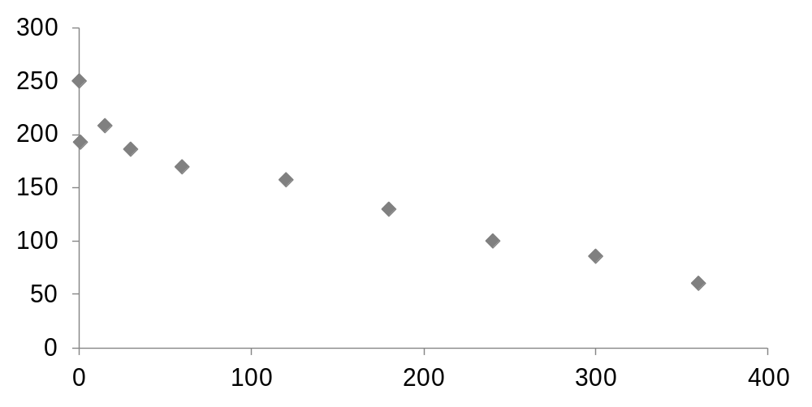
H₂S Depletion
[H₂S] (μM)
Time (min)
H₂S depletes from solution over time
Notes:
Limited protection time due to this depletion
Control delivery of H₂S is needed
H₂S depletes by:
Metabolism by tissues
Escape from solution
over time
This is a plot of just volatile escape from solution over 6 hours (no contribution from tissue metabolism); with tissue metabolism the drop off would be faster and more dramatic.
10

Slide 11
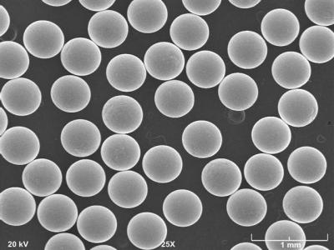
Microspheres: A Method for H₂S Delivery
Gelatin polymer networks
Means of controlled drug delivery
  Can control crosslinkage and loading concentration
  Sustain levels of H₂S release
Microspheres <10 µm do not cause clots¹
http://blogs.indium.com/blog/jim-hisert/microspheres-for-mems
1. Hoshino et al. 2006
Notes:
Use jello/gelatin crosslinking to explain this
Gelatin particles
Hydrogels (polymer networks)
Sustains levels H₂S release in solution
Can control crosslinkage and loading concentration
Means of controlled drug delivery
11

Slide 12
Research Question
How can H₂S be safely and effectively delivered to prolong organ storage?
Hypothesis
A controlled drug delivery method can sustain H₂S levels in the heart and induce protective effects
Notes:
Approach
H₂S is a compound thought to induce suspended animation and prolong organ storage
Idea: To modify clinical static cold storage procedures using hydrogen sulfide (H₂S)
12

Slide 13
Objectives
Develop gelatin microspheres for controlled release of H₂S
Determine the effects of H₂S on rat cardiomyocytes
Determine the efficacy of sustained H₂S on rat hearts

Slide 14
Objective 1
Develop gelatin microspheres for controlled release of H₂S
  Effect of varying crosslinkage
  Effect of varying loading concentration

Slide 15
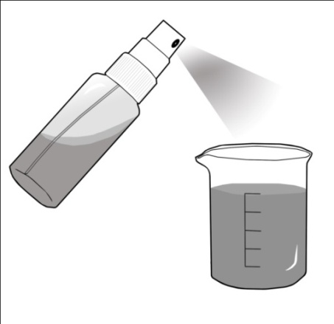
Microsphere Fabrication Method
1) Fabricate microspheres
(vary crosslinkage)
Microspheres
2) Load microspheres
with NaHS
4) Read absorbance
3) Zinc acetate assay
Notes:
Measure H₂S using an absorbance assay
Microsphere fabrication
Vary cross-linkage using glutaraldehyde
Microsphere diameter <10µm

Slide 16
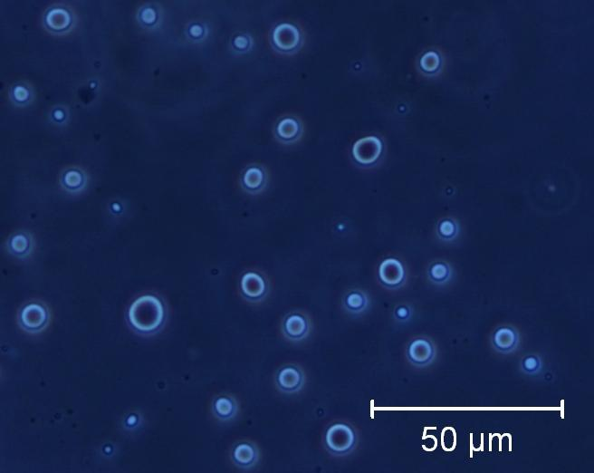
Microsphere Size Distribution
n=144
Microspheres less than 10 μm can be fabricated
Notes:
Say average and standard deviation: 4.62± 1.54 µm, n=144 microspheres
16

Slide 17
Effects of NaHS Loading Concentration
Uptake of H₂S by microspheres increases with loading concentration
Notes:
“H2S uptake” is amount of H2S absorbed by the gelatin cylinders (in nanomoles). It is the difference in amt of H2S in the bulk solution between time = 0 and time = 60 minutes, taking into account the amt of H2S that is lost to the atmosphere.
[Amt H2S absorbed into cylinders = (Amt start @ t =0) – (Amt remaining @ t=60 min) – (Amt that went into atmoshpere**)
**given by control data (Amt start @ t =0) – (Amt remaining @ t=60 min), which had only had loading solution, and no gelatin discs
* Indicate p<0.05
P values are: 0.0006 between 25 vs 50 mM load, and 0.003 between 50 and 100 mM

Slide 18
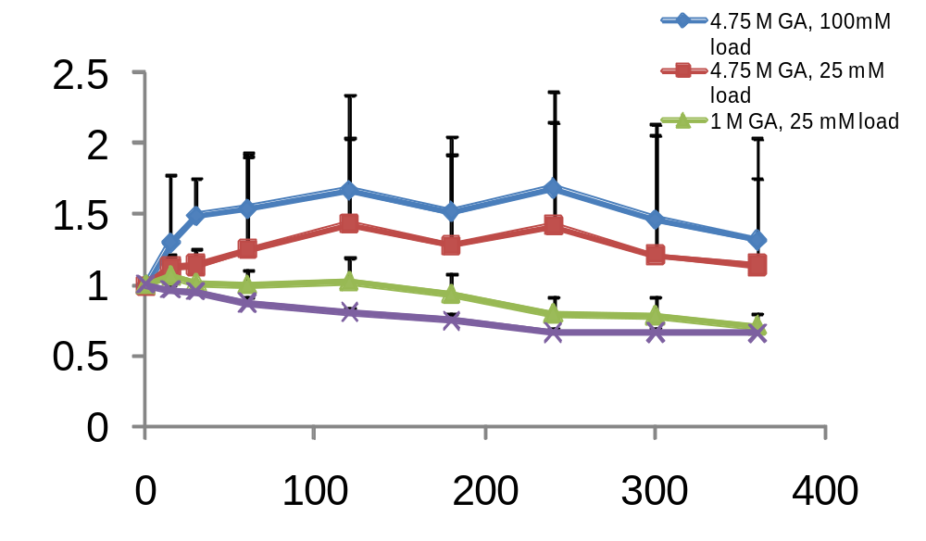
Release of H₂S by Microspheres
Relative H₂S levels
Time (min)
Microspheres enable controlled release of H₂S
Notes:
(4C) Change in bulk solution concentration over time for experimental and control (no microspheres) groups. Bulk concentration (as fraction of initial bulk concentration at t= 0.5 min) over time (minutes). Thus a value of “1” means “same concentration as at t = 0.5 min.
The data supports why microspheres are necessary to keep the concentration of H2S from dropping (as quickly).
The concentration in the control group continuously falls, ends up at 66% of initial concentration.
4.75 M GA, 100 mM loaded microspheres keep the bulk solution from decreasing in concentration, presumably by releasing H2S throughout the period. The other two experimental groups are not as effective throughout the timeframe. Data demonstrates the efficacy of high cross-link density and high loading concentration at keeping the bulk solution concentration from dropping.
* Indicates p < 0.05 significance level compared to control.

Slide 19
Objective 2
Determine the effects of H₂S on rat cardiomyocytes
  Effect of H₂S on cell viability
  Effect of H₂S on cell metabolism
Notes:
19

Slide 20
MTT Assay Method
1) Add NaHS to H9c2 cells
2) Add MTT reagent to media
3) Add MTT solubilizing solution
4) Read absorbance
Notes:
MTT assay
Cell metabolic activity
Colorimetric assay

Slide 21
Effects of H₂S on Metabolic Activity
Relative absorbances
[H₂S] (μM)
Incubation with 10,000 μM H₂S increases metabolic activity
Notes:
THIS NEEDS P-VALUES or at least HOW STATISTICAL SIGNIFICANCE WAS DETERMINED
Make corrections to axes titles

Slide 22
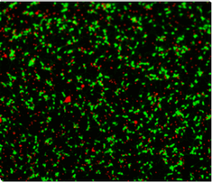
Method: Live-Dead Assay
1) Add microspheres to H9c2 cells
2) Add stains
Live
Dead
3) Count live cells
http://www.invitrogen.com/site/us/en/home/Products-and-Services/Applications/Cell-Culture/primary_cell_culture/Neuronal-Cell-Culture/rat-cortex-and-hippocampus-neurons.html
1) Add microspheres + NaHS
to H9c2 cells
Notes:
Incubate cells with either microspheres or microspheres + X M NaHS for (X HOURS) and stain with 2 fluorscent dyes---red dye marks cells that have lost plasma membrane integrity and green dye marks healthy cells, therefore can determine % of live cells after exposure to NaHS and microsphere materials.
Live/dead assay
Cytotoxicity
Colorimetric assay

Slide 23
Effects of NaHS on Cell Viability
Mass of microspheres (mg)
Addition of 250mg NaHS-loaded microspheres may
improve cell viability
Notes:
NEEDS P VALUES
don't go over the results too fast!
- EXPLAIN AXIS ("this graph shows 'y' as a function of 'x' - from this graph we see...'result' "
- show picture of live/dead stain
- explain that 0 and 50mg are significantly different
WHAT CONCENTRATION NAHS WAS USED HERE! THIS IS CRUCIAL
23

Slide 24
Objective 3
Determine the efficacy of sustained H₂S on rat hearts
  Hematoxylin and eosin (H&E)
  Caspase-3
  ATP

Slide 25
Surgical Method
Sprague-Dawley rats anesthetized with ketamine and xylazine
Abdominal midline incision
Heparin injected into inferior vena cava prior to exsanguination
Cardioplegia induced
  Heart was cooled with saline
  UW solution injected into proximal ascending aorta
Vessels were ligated and cut

Slide 26
Tissue Treatment Method
Control groups
C-frozen: frozen immediately after explantation
C-ischemia+UW: warm ischemia prior to storage
C-UW: University of Wisconsin (UW) solution

Slide 27
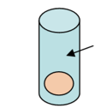
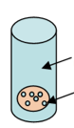
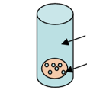
Tissue Treatment Method
Experimental groups
E-UW+NaHS: UW solution with 25 mM NaHS
E-UW+μS: saline-loaded microspheres
E-UW+μS+NaHS: microspheres soaked in NaHS solution
NaHS in
UW solution
NaHS in
UW solution
NaHS in
UW solution
PBS-loaded
microspheres
NaHS-loaded
microspheres
E-UW+NaHS
E-UW+μS
E-UW+μS+NaHS

Slide 28
Histology - H&E
Frozen tissue samples were sliced to 6 µm-thick sections on a cryostat
H&E Stain
  Visualize morphology of tissue sample
  Hematoxylin: stains nucleic acids blue-purple
  Eosin: stains proteins pink
  Reveal tissue damage, inflammation

Slide 29
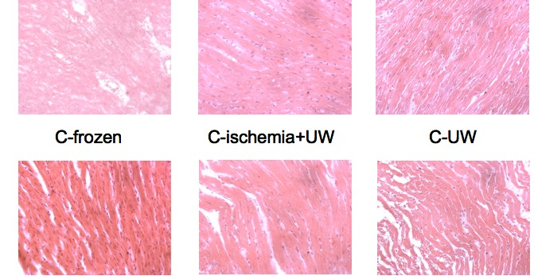
H&E Staining of Rat Heart Tissue
100 μm
C-frozen
C-ischemia+UW
C-UW
E-UW+NaHS E-UW+μS E-UW+μS+NaHS
Neither H₂S nor microspheres produce a significant inflammatory response
Notes:
29

Slide 30
Histology - Caspase-3
Caspase-3
  A key protein activated in the early stages of apoptosis, or cell death
  Utilize an immunoenzymatic reaction to visualize caspase-3

Slide 31
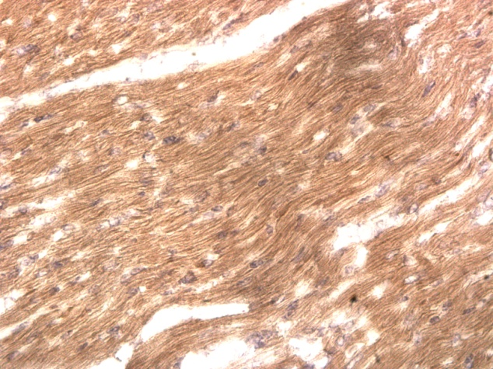
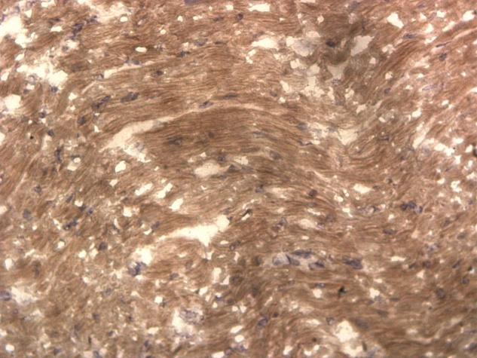
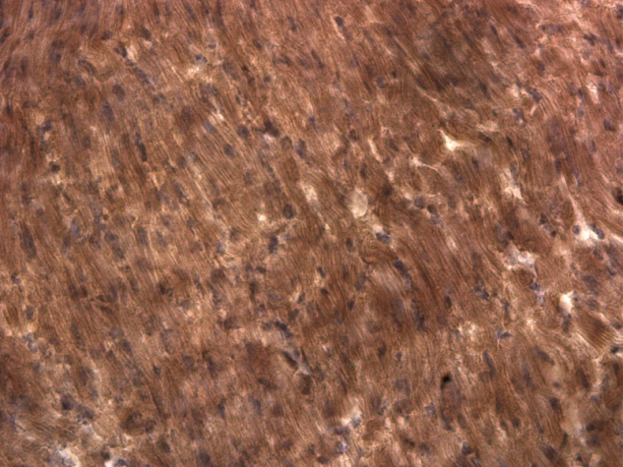
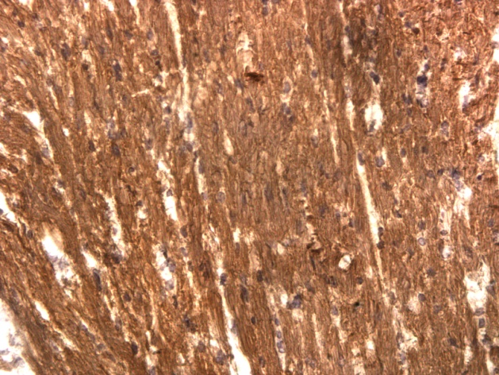
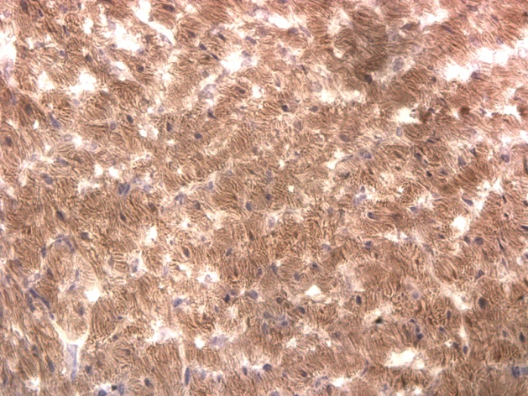
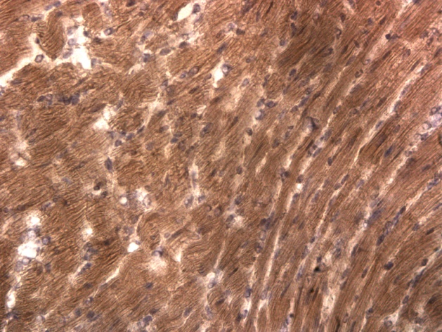
Caspase-3 Stain of Rat Heart Tissue
100 μm
C-frozen
C-ischemia+UW
C-UW
E-UW+NaHS E-UW+μS E-UW+μS+NaHS
Neither H₂S nor microspheres increase apoptosis expression
Notes:
- SCALE BARS
- remember, we're not going to compare intensity!!
- say assay is for measuring stained area, not stained intensity

Slide 32
ATP Assay Method
Frozen samples of left ventricular tissue
ATP Colorimetric/Fluorometric Assay Kit (Abcam, Cambridge, MA)
  ATP content assessed at 3 timepoints
  ATP content calculated as mM/mg
Notes:
Objective: measure ATP concentration, from which we can speculate about heart viability
all tissue samples taken from the left ventricle
Used the fluorometric protocol, which yields more sensitive measurements
ATP content calculated as mM/mg so that we could control for the mass of the tissue sample (which varied from sample to sample)

Slide 33
ATP Concentration as a Measure of Tissue Viability
ATP concentration reflects the hearts energy reserve
The heart especially depends on ATP content, as opposed to other organs
  Maintenance of contractile function following storage ¹
  ATP content correlated with heart function after reperfusion ^{2,3}
Hegge, Southard, & Haworth, 2001
Wang et al., 1991
Peltz, 2005
Notes:
ATP is depleted in an explanted heart due to continued metabolism
Suspended animation
decrease metabolism
greater ATP content
References
Hegge, J.O., Southard, J.H., Haworth, R.A. (2001). Preservation of metabolic reserves and function after storage of myocytes in hypothermic UW solution. Am J Physiol Cell Physiol, 281:758-772.
Peltz, M., He, T-T., Adams, G.A., Koshy, S., Burgess, S.C., Chao, R.Y., Meyer, D.M., Jessen, M.E. (2005). Perfusion preservation maintains myocardial ATP levels and reduces apoptosis in an ex vivo rat heart transplantation model. Surgery, 138(4), 795-805.
Wang, T., Batty, P.R., Hicks, G.L.J., DeWeese, J.A. (1991) Long-term hypothermic storage of the cardiac explant, Comparison of four solutions. J Cardiovasc Surg (Torino) 32: 21-25. *as cited in Hegge et al., 2001

Slide 34
Effect of Storage Method on ATP Expression
ATP concentration decreases over time
Notes:
- when talking about the control/experimental group, SAY the full names (don't necessarily have to put the full names on the slide)(instead of referring to them as CO, say what it is)

Slide 35
Effect of Storage Method on ATP Expression
H₂S prolongs ATP preservation
Notes:
- when talking about the control/experimental group, SAY the full names (don't necessarily have to put the full names on the slide)(instead of referring to them as CO, say what it is)
35

Slide 36
Conclusions
Fabricated microspheres in desired size range
  Microspheres yield sustained release of H₂S
Released levels of H₂S are not harmful to heart cells
H₂S prolongs ATP preservation
No significant differences in tissue damage with H₂S or microsphere treatment
Notes:
**RESTATE RESEARCH QUESTION TO BEGIN WITH**
SAY: Sustained release can be manipulated by controlling loading concentration and degree of crosslinkage
- bring back to our goals
- we've done a lot and added to science :)

Slide 37
Future Directions
Alternate measures of in vivo effects
  Quantitative apoptosis measures
  Functional recovery with reperfusion
Test the system on a larger mammalian subject
  Ex. Swine
Evaluate effects on different organs
Notes:
- change tone - we won't be doing this but we SUGGEST other groups to this in the future

Slide 38
Acknowledgements
The Gemstone Program
Howard Hughes Medical Institute (HHMI)
Dr. Fisher’s Lab
Mr. Bob Kackley
Mr. Tom Harrod
Dr. Agnes Azimzadeh
Dr. Svetla Baykoucheva
Mr. Chao-Wei Chen
Dr. Nancy Lin
Dr. Ian White
Mr. Andrew Yeatts

